Slide 1

S3 Case Study Project
Group 10: Francisco Marcó
Kaloyan Andreev
Sava Vasilev
A flight management infrastructure solution

Slide 2


Agenda
Recap
Development update
New architecture components
Test Plan
Demo
Future work
MDP
Conclusion

Slide 3
Recap

Slide 4


Our solution
IaaS to provide infrastructure to flight agencies
Allow bookings, scheduling, flight management
Manage payments and user information
Provide an easy, accessible experience to travelers and tourists

Slide 5




User Requirements Specifications
Simplify and speed up internal operations for a more efficient pipeline
Ensure customer success experience with CS tools
Save up money and time
Secure Cloud based environment

Slide 6
Development update

Slide 7


OnlyFlights webpage
Upgrades so far
Host on ECS fargate
Implementation of Application Load Balancer to regulate the traffic
Prepared solution in case of failover
New features
Secure connection by using HTTPS protocol

Slide 8


CI/CD Pipelines
Progress so far
GitLab CI/CD pipelines implemented to AWS ECS
Image is pushed to ECR repository
Git runner tests the webapp by using its shell
New fargate tasks are deployed

Slide 9


VPN and off-site backup
In progress
Configure openVPN Server on EC2 instance
pfSense used for off-site RDS backups in Infra-Lab

Slide 10
New architecture components

Slide 11


Deliverables
ECS cluster
Route53: registered domain & dns records implemented
GitLab CI/CD Pipelines
Open VPN & off-site backup

Slide 12
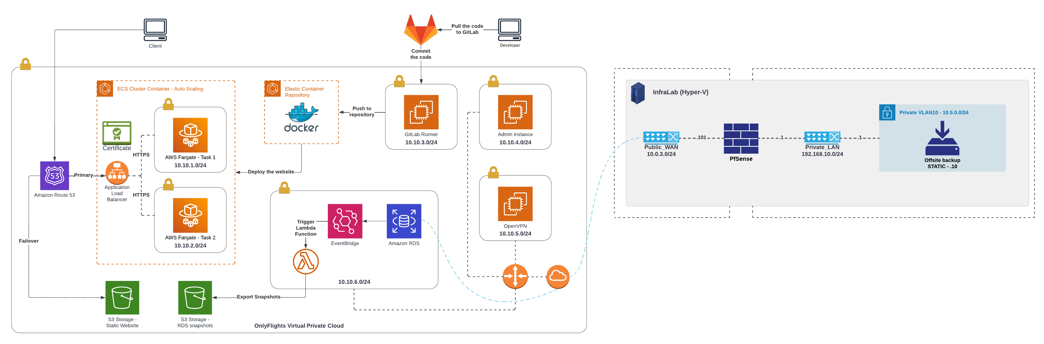
Cloud environment

Slide 13
Test plan

Slide 14
Three aspects to test
INFRASTRUCTURE
application
security

Slide 15
Scope
Infrastructure
Infrastructure & its components are functional and cost efficient
Application
Website is functional and accessible
Security
Pen-testing, Data classification, GDPR
Security measures (hash passwords, store data, authentication.)
Secrets management

Slide 16
Demo

Slide 17
Future work

Slide 18
Future work
Chat server
Finish VPN and Off-site backup
Configure Monitoring
Update of the documentation

Slide 19
Multi-disciplinary project

Slide 20
Chosen project - IQADOT
Knowledge base for business and education primarily
Based on providing a singular answer to a question in a channel based (slack, discord) format
Client: Ali Odac
Tutor: Mikaeil Shaghelani

Slide 21
MVP1 Release
CI/CD Pipelines
ECS EC2 Container
SQL database
Apache webserver
Login/register application
GitLab Repository
Pushes code into ECS container

Slide 22
Network architecture

Slide 23
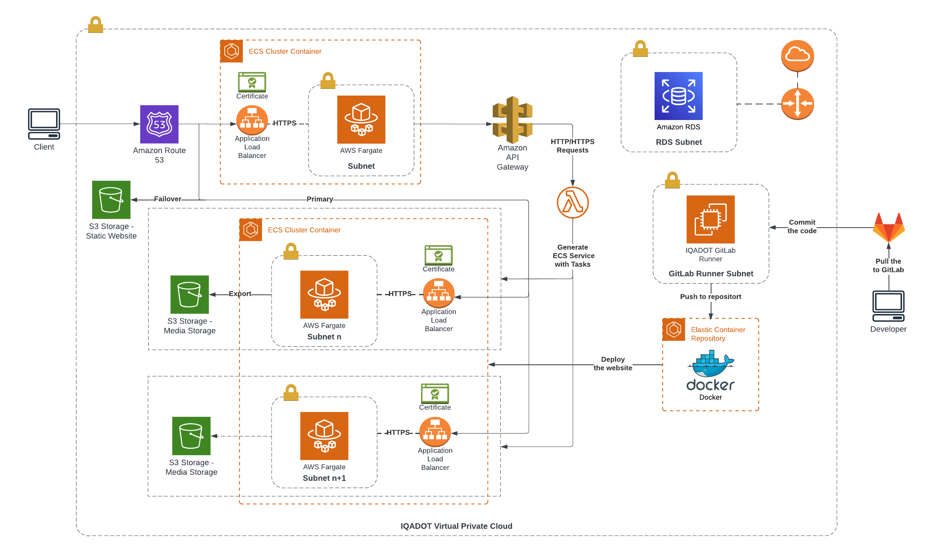

Slide 24
Conclusion

